Slide 1

DATABASES AND APPLICATIONS
SUBJECT CODE : UQ23CA653A
Samyukta D Kumta
Computer Applications

Slide 2
DATABASES AND APPLICATIONS
UNIT-IV- Database Model
A database model is the logical representation of the database i.e. the constraints and the relationship between the stored data. The database model is usually represented in the form of flow diagrams called database diagram. There are various types of database models such as
Relational
Hierarchical Model
Network
Hybrid
Object Oriented Model

Slide 3
DATABASES AND APPLICATIONS
UNIT-IV- Relational Database Model
Relational Model
The relational model for database management is an approach to logically represent and manage the data stored in a database. I
n this model, the data is organized into a collection of two-dimensional inter-related tables, also known as relations.
Each relation is a collection of columns and rows, where the column represents the attributes of an entity and the rows (or tuples) represents the records.

Slide 4
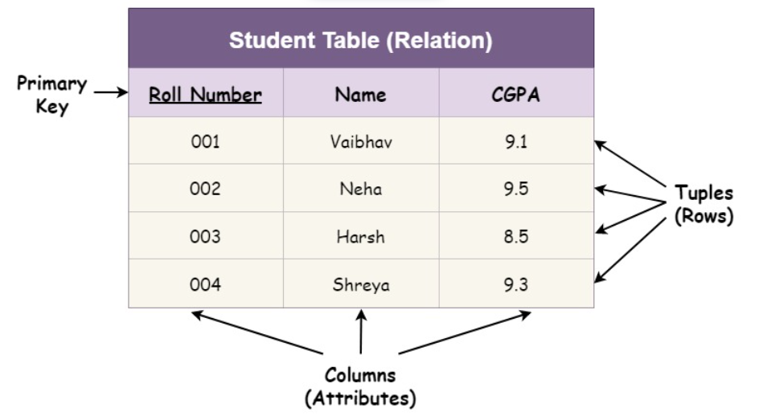
DATABASES AND APPLICATIONS
UNIT-IV- Relational Database Model
Relational Model

Slide 5
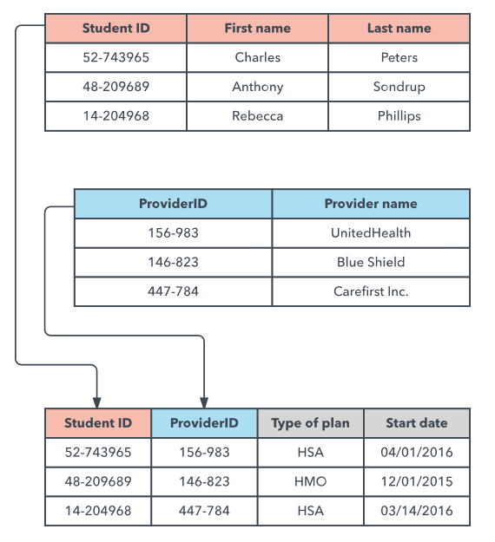
DATABASES AND APPLICATIONS
UNIT-IV- Relational Database Model
Relational Model

Slide 6
DATABASES AND APPLICATIONS
UNIT-IV- Hierarchical Database Model
Hierarchical Model (PCR)
The oldest model, dating from 1960’s
Gives “Ad Hoc” solution to immediate needs of real applications
The oldest hierarchical database system, IBM’s IMS, was developed to organize and store information needed by the space program for the Apollo Landing Project.
The first hierarchical DBMS is “IMS” and it was released in 1968.
“IMS” is still the dominant DBMS.

Slide 7
DATABASES AND APPLICATIONS
UNIT-IV- Hierarchical Database Model
Hierarchical Model
Process data efficiently. (Access, Storage, Filter and share)
It uses a structure familiar to program.
Provides predictable performance since all paths are known.
However not as flexible or as easy to understand as relational system..

Slide 8
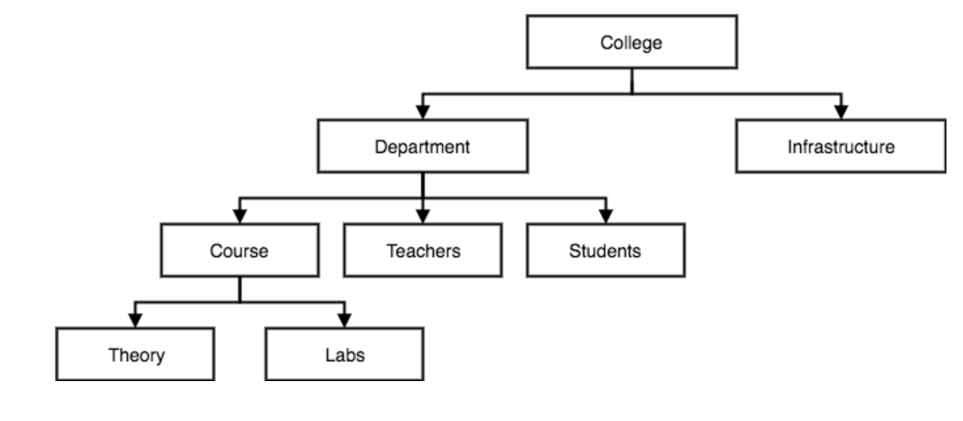
DATABASES AND APPLICATIONS
UNIT-IV- Hierarchical Database Model
Hierarchical Model

Slide 9
DATABASES AND APPLICATIONS
UNIT-IV- Hierarchical Database Model
Applications of Hierarchical Model
Due to their layered and organized nature, the Hierarchical Model in DBMS has many applications.
Data Organization: Hierarchical models excel at data organization using parent-child connections. This is useful for expressing structures such as organizational charts or file systems in databases.
Biological Sciences: Hierarchical models in taxonomy classify species based on shared features, assisting scientists in understanding evolutionary relationships.

Slide 10
DATABASES AND APPLICATIONS
UNIT-IV- Hierarchical Database Model
Applications of Hierarchical Model
Image Processing: By dividing large pictures into manageable parts, hierarchical image segmentation facilitates object detection and tracking.
Natural Language Processing: Language parsing with hierarchical models aids in understanding phrase structures, which is necessary for translation and sentiment analysis.
Control Systems: Hierarchical control models improve efficiency and control by splitting complicated systems into manageable components.

Slide 11
DATABASES AND APPLICATIONS
UNIT-IV- Hierarchical Database Model
Applications of Hierarchical Model
Artificial Intelligence: Hierarchical models aid in feature learning in AI. Deep learning networks find complicated patterns in data using hierarchies.
Economics: For more accurate forecasts, hierarchical models analyze economic data at many levels, such as individual, regional, and global.
Geography: Hierarchical models depict places of various sizes, from continents to streets.

Slide 12
DATABASES AND APPLICATIONS
UNIT-IV- Hierarchical Database Model
Applications of Hierarchical Model
Computer Graphics: Hierarchical rendering improves realism by directing processing power on regions that require detail.
Risk Management: Hierarchical models measure risk by analyzing aspects at various levels, assisting in financial and insurance decision-making.

Slide 13
DATABASES AND APPLICATIONS
UNIT-IV- Hierarchical Database Model
Example:1
Conversion of Relational Database Model To Hierarchical Database Model
Organization
This would be the root of the hierarchy.
2.Department
Each department from the "Departments" table becomes a child node under the "Organization" node.
3.Employee
Each employee from the "Employees" table becomes a child node under the corresponding department node.

Slide 14
DATABASES AND APPLICATIONS
UNIT-IV- Hierarchical Database Model-Implementation
{ "Organization": {
"Department": [
{
"department_id": 1,
"name": "Engineering",
"Employee": [
{
"employee_id": 101,
"name": “KIRAN"
},
{
"employee_id": 102,
"name": “PRAVEEN"
}
] },
{
"department_id": 2,
"name": “MCA",
"Employee": [
{
"employee_id": 201,
"name": "MANJUNATH"
}
]
}
]
}
}

Slide 15
DATABASES AND APPLICATIONS
UNIT-IV- Hierarchical Database Model
Example:2
Convert Bank Relational Database model to Hierarchical Model
Convert plant Taxonomy ERD in Hierarchical model.

Slide 16
DATABASES AND APPLICATIONS
UNIT-IV- Hierarchical Database Model
The hierarchical structure allows for easier traversal and representation of relationships between departments and employees.
It's important to note that hierarchical models might not always capture the complexity of relational databases accurately, especially in cases where relationships are many-to-many or require more nuanced representations.

Slide 17

THANK YOU
Samyukta D Kumta
Department of Computer Applications
samyuktad@pes.edu

